Slide 1

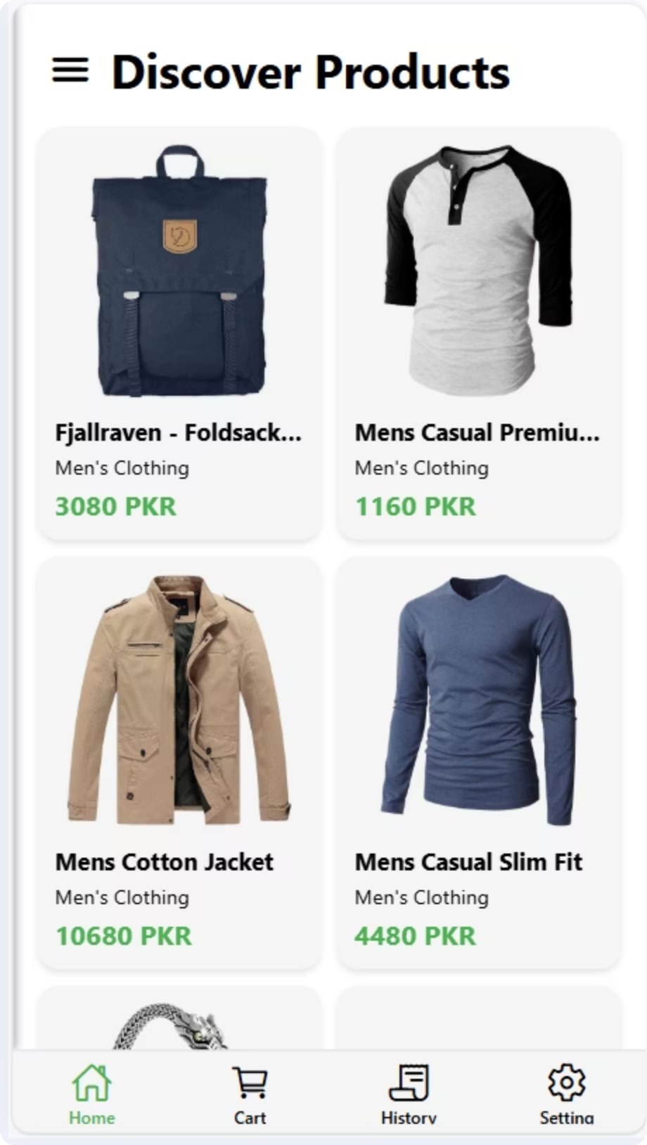
E-Commerce Product Management System
PRESENTED BY:
SP23-BSCS-0044 (UMAIMA MUSHTAQ)

Slide 2

Under the Hood: Our Technology Stack
Frontend: React Native
Backend: .NET
Authentication: JWT
Cross-platform mobile app development
Robust, scalable server-side logic
Secure, stateless token-based authorization
API services
Native feel
Security: OTP
Architecture: Role-based Access
Enhanced account protection
Tailored Admin and User experiences
One-Time Password (OTP) verification
Role-based permissions

Slide 3

Project Overview & Core Objective
Comprehensive mobile e-commerce product management system.
Built with modern technology stack.
Supports distinct Admin and User roles with tailored features.
Primary Goal: Create a secure, and efficient mobile application.
Streamlines product management and simplifies order handling.
Offers a smooth, engaging shopping journey for all users.

Slide 4
Feature Set
Role-based Authentication
Admin Product Control
Role-based authentication for Admin and User.
Admin can add, update, delete, and view products.
User Shopping Experience
User-Friendly UI
Users can browse products and place orders.
Clean and user-friendly mobile UI theme.
Secure RESTful API
Centralized Data Storage
Secure RESTful API using .NET backend.
Centralized data storage using SQL Server (SSMS).

Slide 5
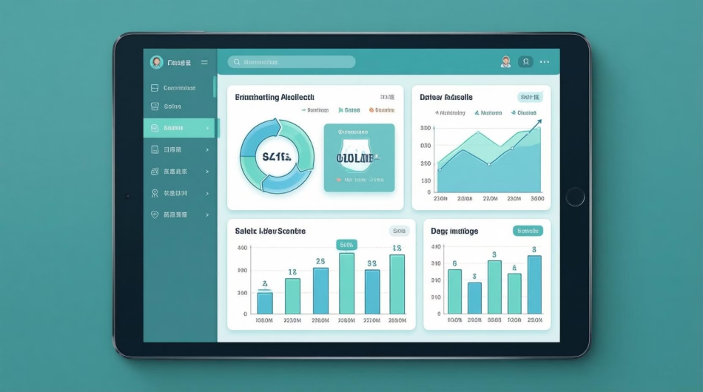

Distinct User Roles, Tailored Experiences
Admin Role
Comprehensive control over products & orders.
Access to application performance insights.
User Role
Seamless shopping journey.
Product discovery to order tracking.

Slide 6
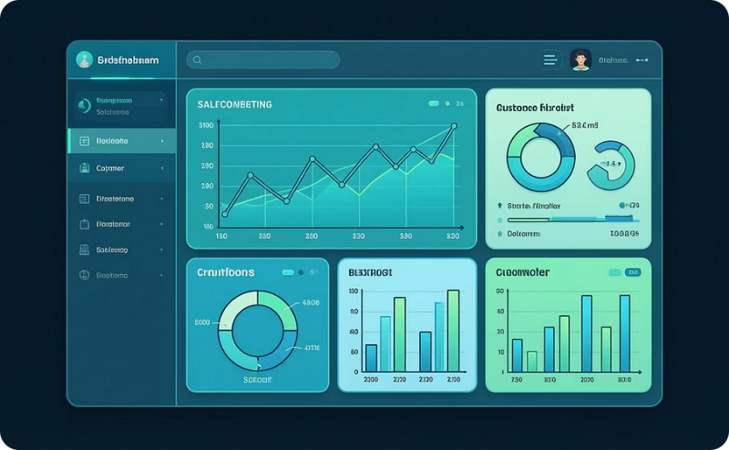



Admin: Command Center Features
The Admin interface provides powerful tools for managing the e-commerce platform efficiently.
Dashboard
Product Management
Order Management
Settings
Monitor total sales
Manage profile & password
Track new customer acquisition
Control product catalog
Access all orders
Add, edit, delete products
Review product, quantity, customer info
Select theme preferences
Oversee platform activity
View comprehensive listings
Ensure smooth fulfillment
Securely log out

Slide 7
Admin Pages & Features
Dashboard
Product Management
Order Management
Settings & Profile

Slide 8
User Pages & Features
Home & Product Catalog
Product Details
Shopping Cart
Checkout
Order History
User Profile & Settings

Slide 9

Robust Authentication & Security
Paramount security
Advanced measures for data protection
Secure transactions
JWT-based Authentication
OTP Verification
Secure API access
Extra security layer
Efficient user session management
Enhanced user protection during signup & login
Role-based Authorization
Granular access control
Authorized users access specific features & data

Slide 10

Conclusion: A Complete E-Commerce Solution
Comprehensive, secure, and user-friendly mobile e-commerce solution.
Separate Admin and User roles for tailored functionality.
Enhanced security with JWT and OTP verification.
Scalable architecture for future growth.
Showcases high-level React Native frontend development.
Delivers a smooth shopping experience and efficient management.

